Slide 1
Parallelizing the Hydraulic Erosion Model with MPI
Ted Toporkov

Slide 2
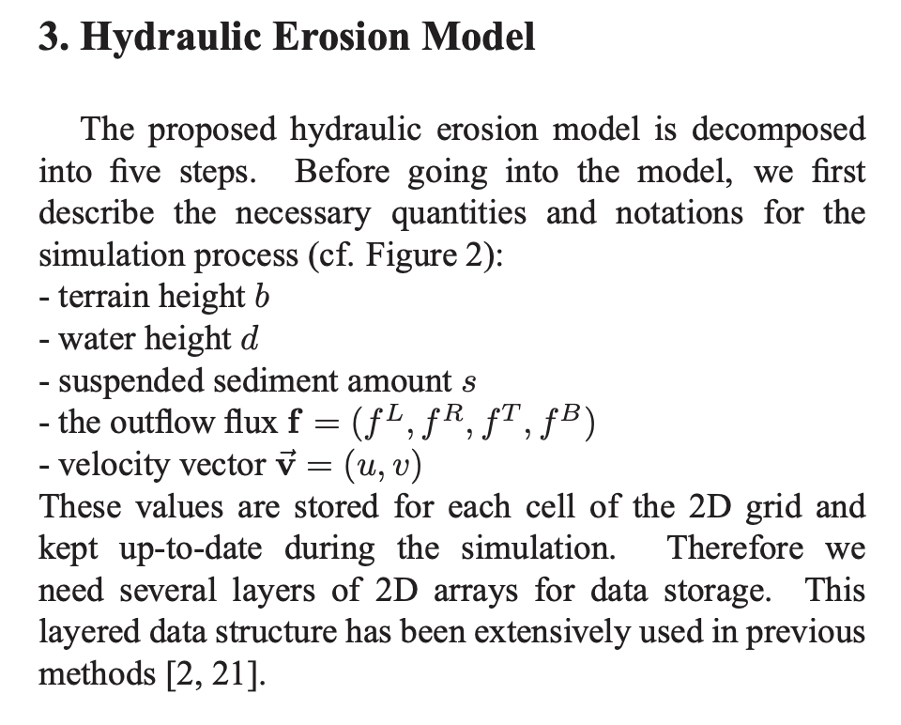
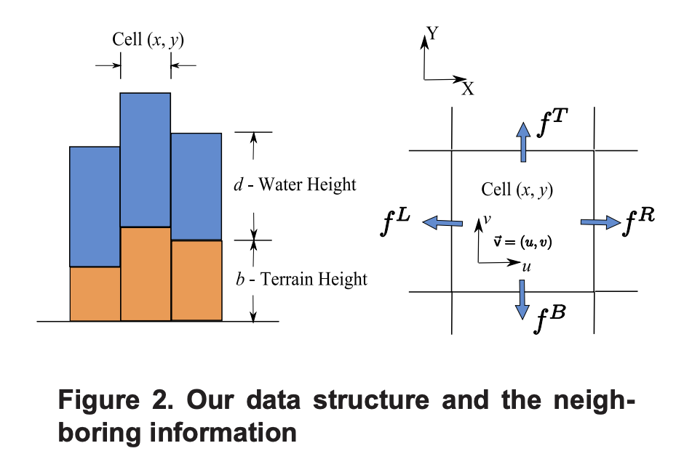
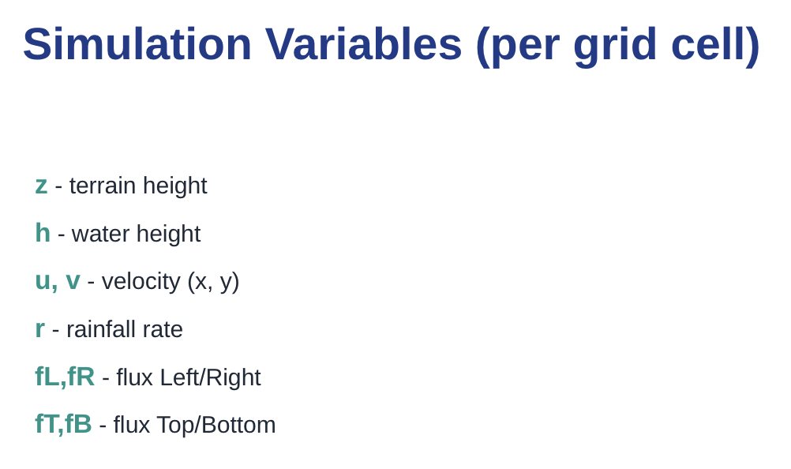

Slide 3
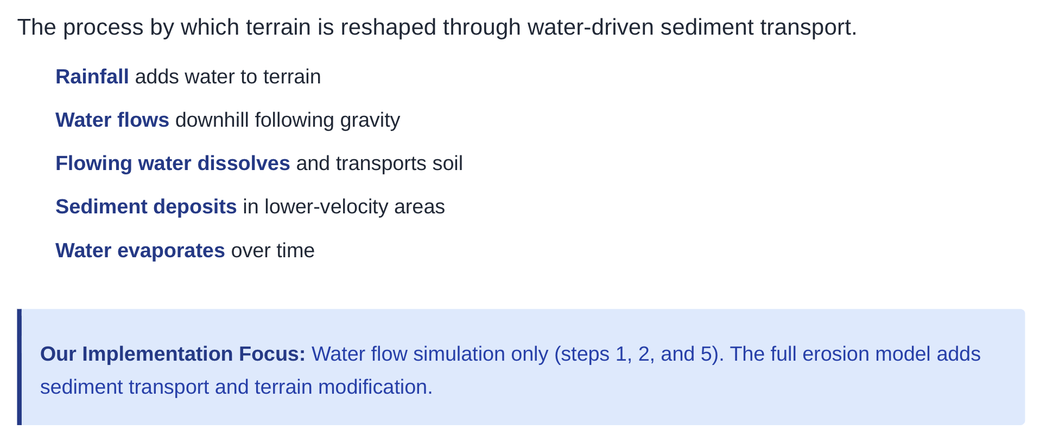
What is Hydraulic Erosion?

Slide 4
Parallelization with MPI
1D decomposition: Split the grid into horizontal strips (one per rank)
Ghost cells: Each rank stores +2 rows (top & bottom halos)
Halo exchange: MPI.Sendrecv exchanges ghost cell data with neighboring ranks
Flow update: Physics calculations (mostly identical to serial version), except:
We first call exchange_halo() to get neighbor data
We apply boundary conditions only on physical domain edges (not between ranks)
Gather results: Snapshots saved periodically for animations

Slide 5
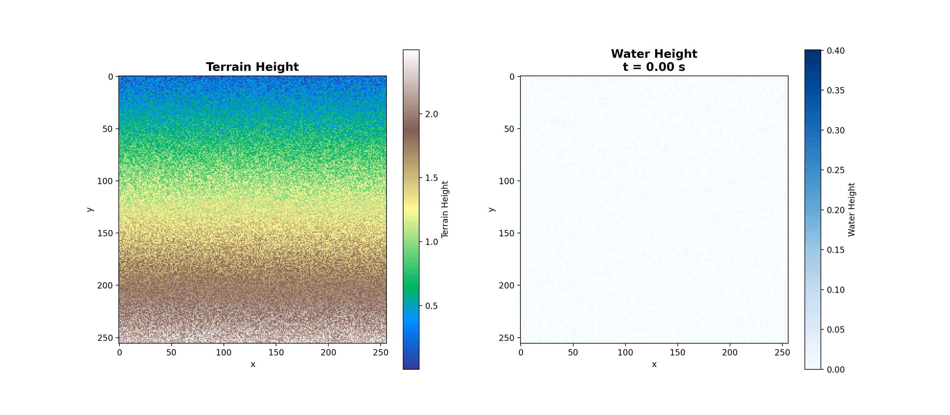
Serial Approach Animation (w/ terrain)

Slide 6

Parallel Approach Animation (4 MPI procs)

Slide 7

Parallel Approach Animation (8 MPI procs)

Slide 8
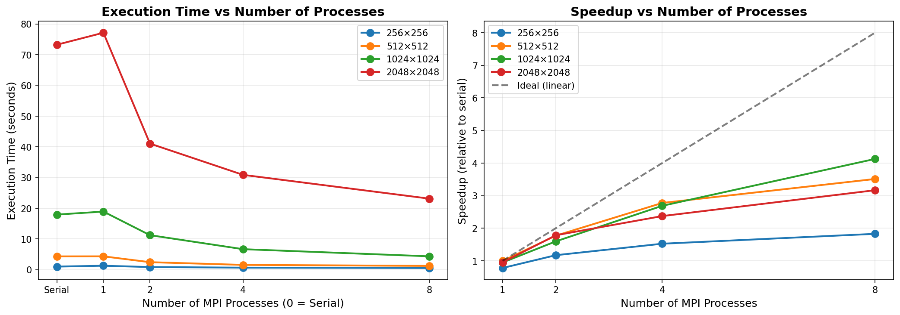
Performance Benchmarking

Slide 9
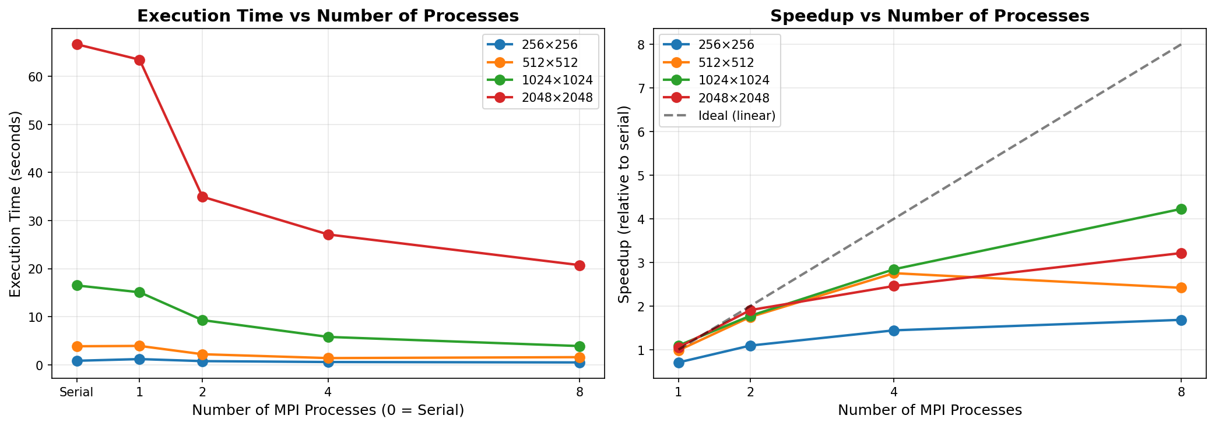
Performance Benchmarking

Slide 10
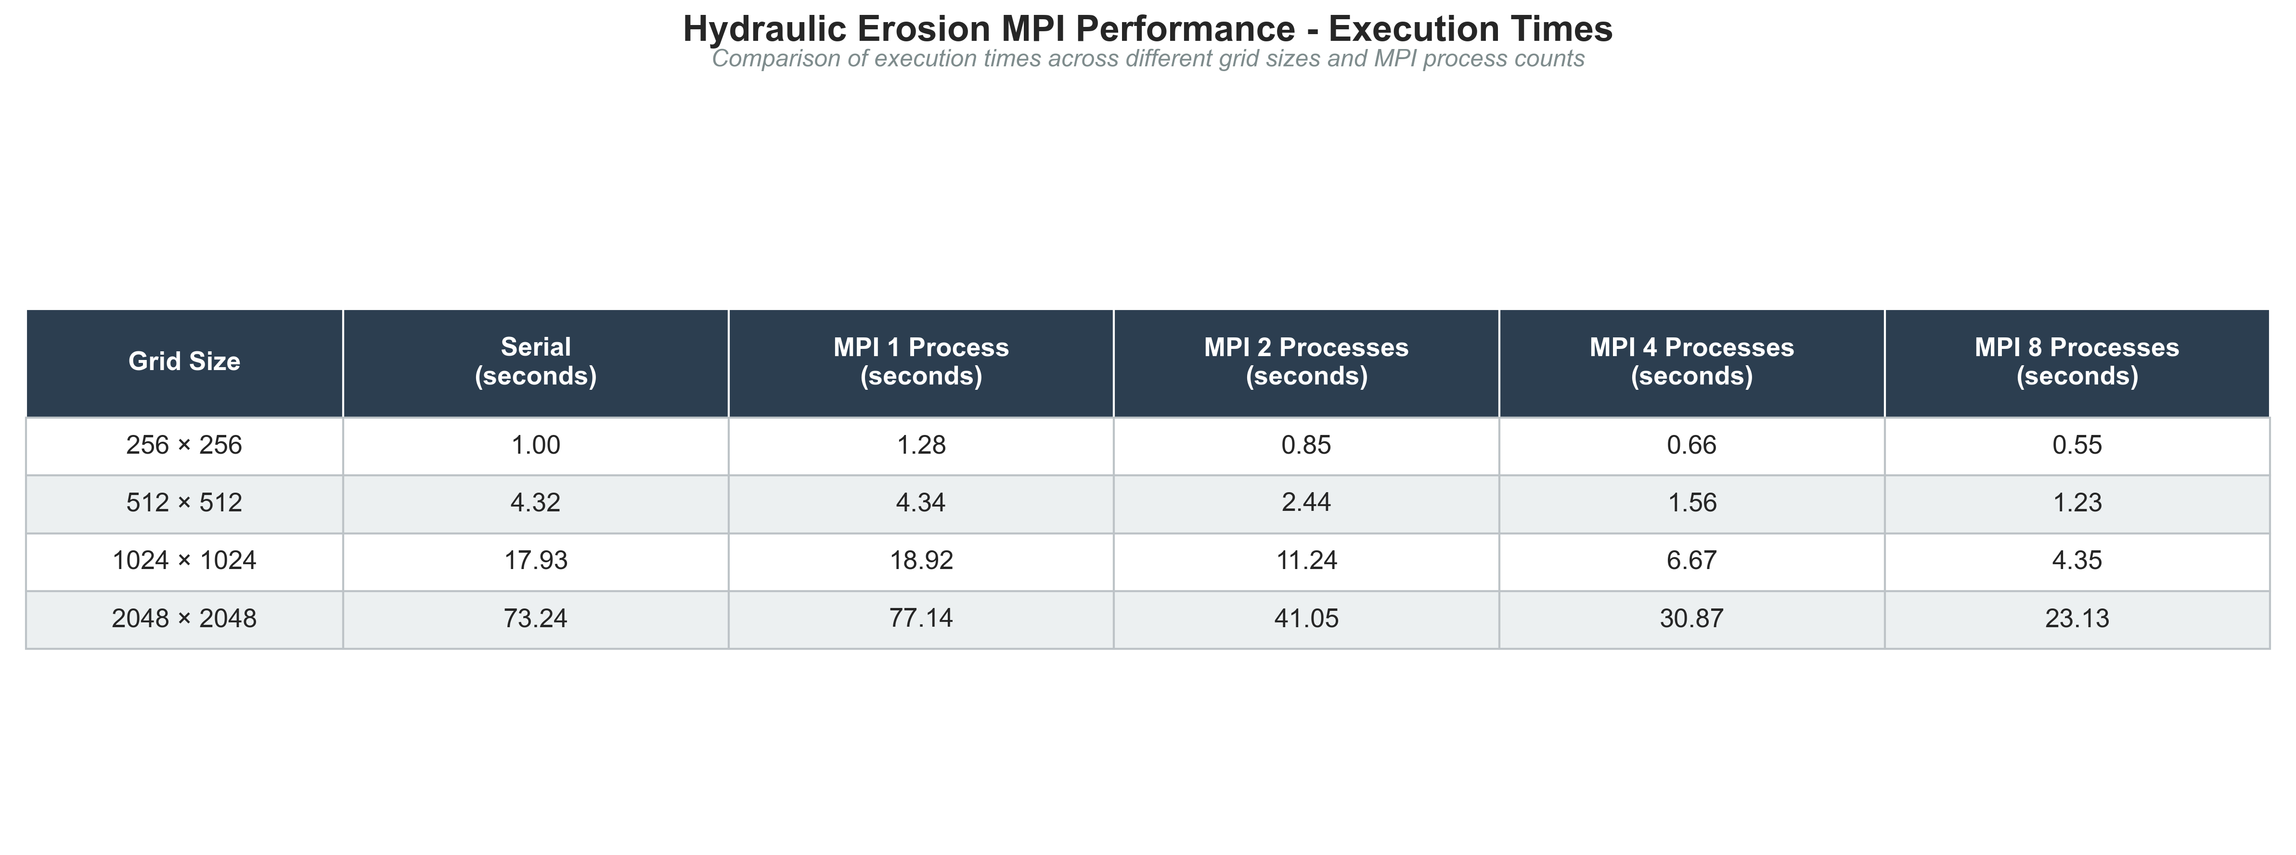

Slide 11
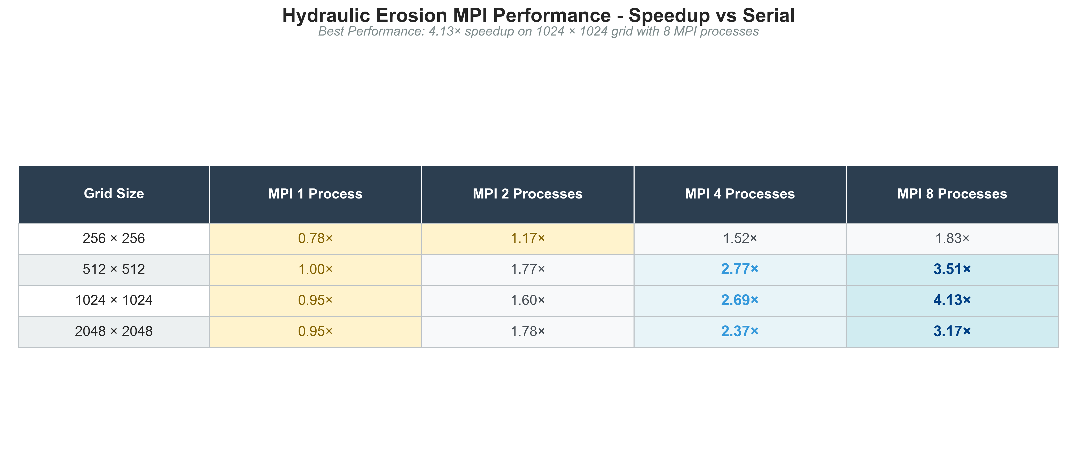

Slide 12
Conclusions
Compared output between serial and parallelized version (should have been the same, but it wasn’t)
Visual comparison of animations shows MPI Rank boundaries (indicates bug(s) in halo exchange implementation)
Animations show what a “wrong” MPI implementation looks like

Slide 13
Sources
Hydraulic Erosion Notebook – https://colab.research.google.com/github/JacobDowns/CSCI-491-591/blob/main/hydraulic_erosion_demo.ipynb
Xing Mei, Philippe Decaudin, Bao-Gang Hu. Fast Hydraulic Erosion Simulation and Visualization on GPU. PG ’07 - 15th Pacific Conference on Computer Graphics and Applications, Oct 2007, Maui, United States. pp.47-56, ff10.1109/PG.2007.15ff. ffinria-00402079f – https://inria.hal.science/inria-00402079/document

